Slide 1






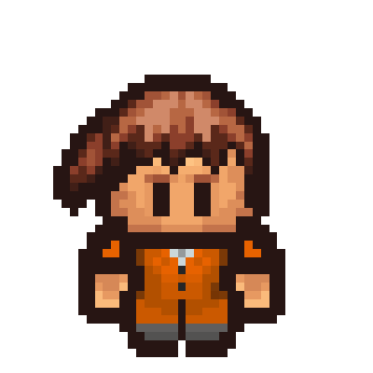


Capstone DSI 9
Customer Segmentation
for an e-commerce retailer from the UK

Slide 2
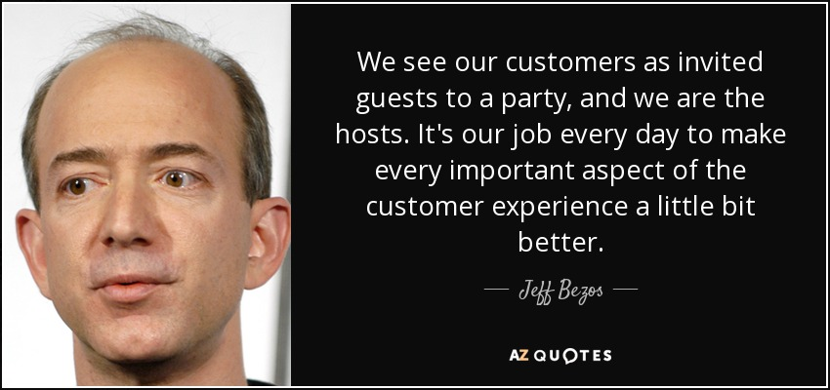
Start with WHY
WHY Customer Segmentation?

Slide 3

Background & Problem Statement
About the dataset:
Source: Kaggle
Date: Between Dec 2010 and Dec 2011
UK-based and non-store online retail.
Mainly sells unique all-occasion gifts.
Most customers of the company are wholesalers.
Problem Statement:
Group and understand the habits of the customers so that the company can gain a deeper understanding of their preferences.

Slide 4
















OBJECTIVE:
Loyal customers
Transaction Data
You can simply impress your audience and add a unique zing and appeal to your Presentations. Easy to change colors, photos and Text. Get a modern PowerPoint Presentation that is beautifully designed. You can simply impress your audience and add a unique zing and appeal to your Presentations. Easy to change colors, photos and Text. Get a modern PowerPoint Presentation that is beautifully designed.
Heavy occasional customers
Light loyal customer
Customers
Occasional customers
Trialist

Slide 5







01
Data Exploration and Findings
Concepts and Terminologies
You can simply impress your audience and add a unique zing and appeal to your Presentations. Easy to change colors, photos and Text. Get a modern PowerPoint Presentation that is beautifully designed. You can simply impress your audience and add a unique zing and appeal to your Presentations. Easy to change colors, photos and Text. Get a modern PowerPoint Presentation that is beautifully designed.
Logic
Product
Transaction 1
Product
Product
Transaction 2
Data and analysis
Notes:
35% cancellation rate
91% Transactions from the UK
Max Quantity item - PAPER CRAFT , LITTLE BIRDIE

Slide 6

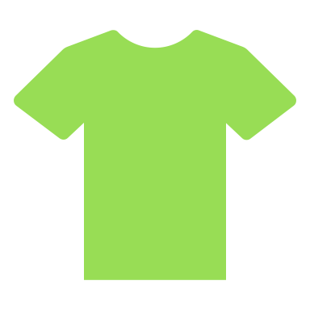

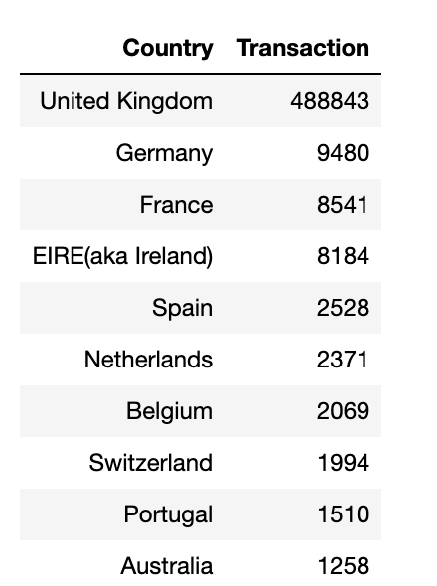



01
Data Exploration and Findings
Some snapshots of the data
You can simply impress your audience and add a unique zing and appeal to your Presentations. Easy to change colors, photos and Text. Get a modern PowerPoint Presentation that is beautifully designed. You can simply impress your audience and add a unique zing and appeal to your Presentations. Easy to change colors, photos and Text. Get a modern PowerPoint Presentation that is beautifully designed.
Items purchased:
Most popular quantity of purchase and median spend on each item:
Max Quantity in one transaction:
Unique Customer ID:
541,909
4,800
5,703
1 - $10-$15
Top 10 Transactions by country
Median Spend per transaction
Highest transactional Month
Cancelled Transactions:
9,725
$300
November
Notes:
35% cancellation rate
91% Transactions from the UK
Max Quantity item - PAPER CRAFT , LITTLE BIRDIE

Slide 7


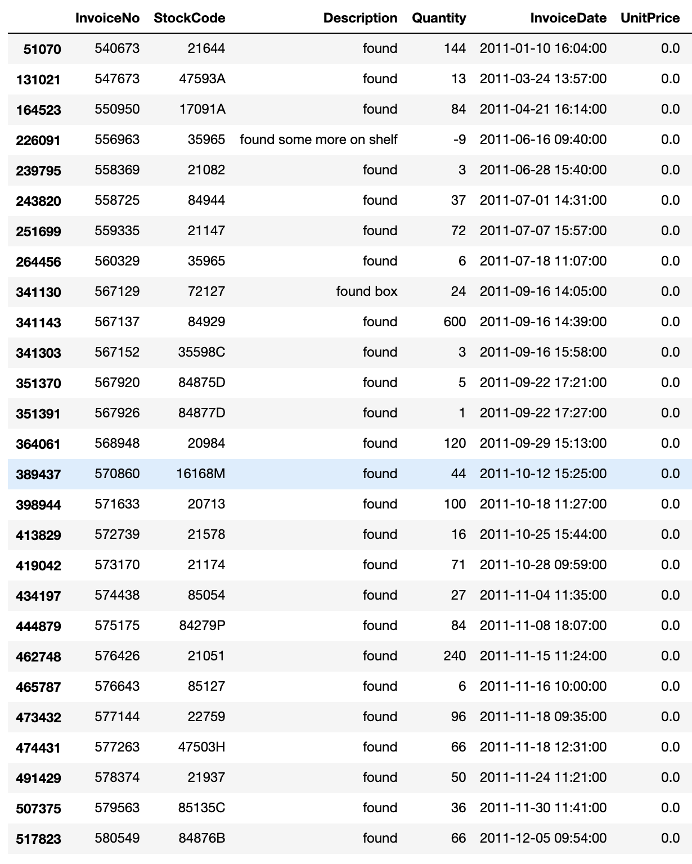

02
Assumptions, Risks and Limitations
Missing data from descriptions
Description not related to products
1,454
178
Missing data from customer ID
135,080
No predefined product categories
Notes:
Assumption 1: Since the rows with missing descriptions does not have a price tagged to it, we will assume it uncompleted transactions and will remove these rows
Assumption 2: We will assume the missing customer ID as new, unregistered customers of the e-commence site and will assign a customer ID for them
Assumption 3: There are 3 rows of Bad Debt adjustments for the same Customer, we will also remove these rows
Assumption 4: There are 27 rows of Description that are not related to the products and just comments, we will also remove these rows

Slide 8








03
Clustering of products into categories
Description
Category A
Description
Description
Latent Dirichlet Allocation
(LDA) Model
Category B
Description
Description
Description
Category C
Description
Notes:
(grouping unique product descriptions in groups that are similar)
Latent Dirichlet allocation (LDA) is a generative statistical model that allows sets of observations to be explained by unobserved groups that explain why some parts of the data are similar.
LDA imagines a fixed set of topics. Each topic represents a set of words.
And the goal of LDA is to map all the documents to the topics in a way, such that the words in each document are mostly captured by those imaginary topics.
A generative model is a statistical model of the joint probability distribution on X × Y, {\displaystyle P(X,Y)}

Slide 9
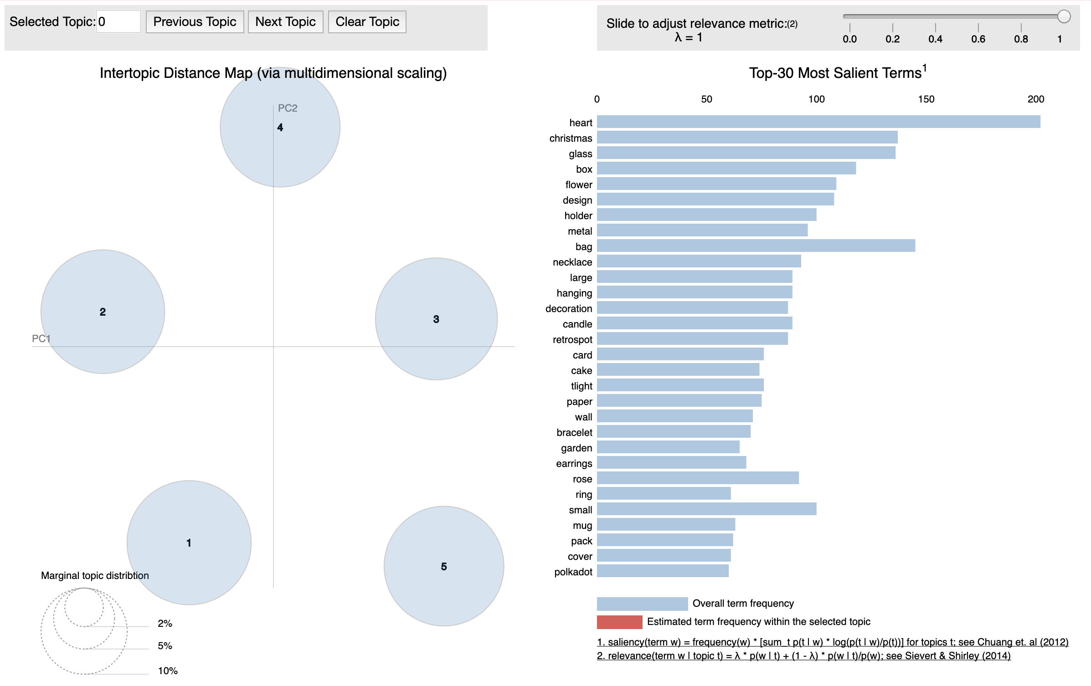
03
Clustering of products into categories

Slide 10
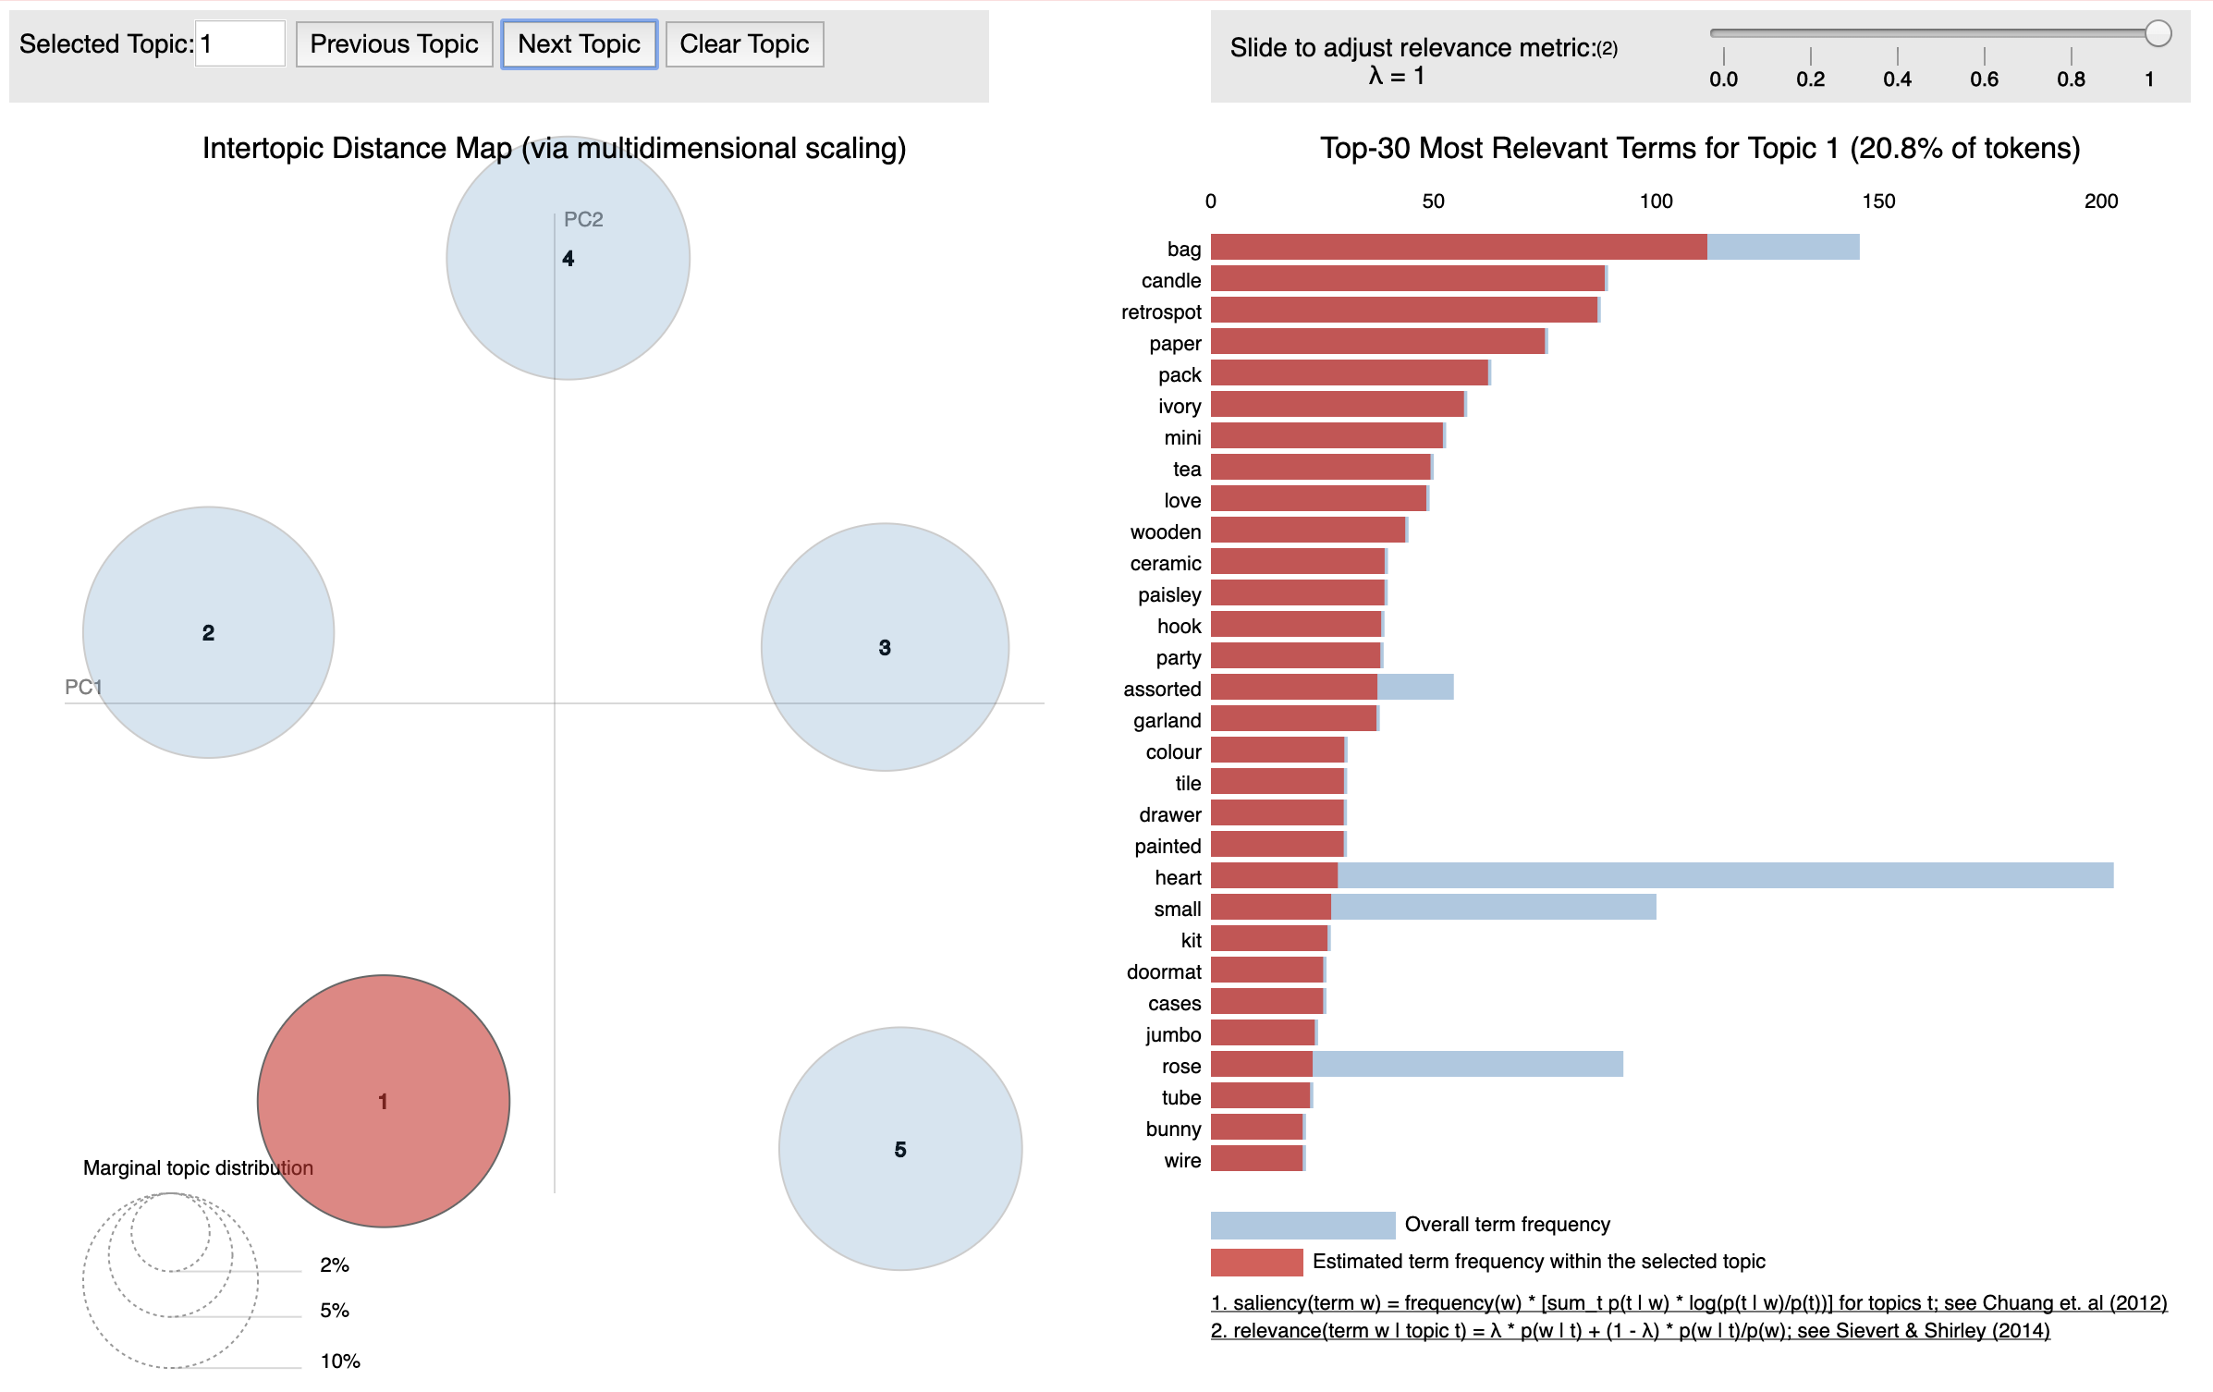
03
Clustering of products into categories

Slide 11

04
Grouping customers into classes
Purchased items
Transactions
Customers
Modelling
Classes
Description
Transaction 1
Transaction 1
Class 1
Description
Transaction 2
Transaction 2
Description
Agglomerative Hierarchical
Clustering
Class 2
Description
Transaction 3
Transaction 3
Unsupervised Model
Description
Transaction 4
Transaction 4
Description
Notes:
hierarchical clustering (also called hierarchical cluster analysis or HCA) is a method of cluster analysis which seeks to build a hierarchy of clusters.
Agglomerative: This is a "bottom-up" approach: each observation starts in its own cluster, and pairs of clusters are merged as one moves up the hierarchy.

Slide 12




04
Grouping customers into classes
Characteristics of each class
Classes
Modelling
Transaction 2
Transaction Count
Class 1
Class 1
Decision Tree
Transaction 3
Accuracy: 99.3%
Registered Member
Supervised Model
Class 2
How much did a customer spend on household items?
Transaction 1
Class 2
Transaction 4
Days since last purchase
Future customers
Class 2
Notes:
Decision Trees are a non-parametric supervised learning method used for both classification and regression tasks.
The goal is to create a model that predicts the value of a target variable by learning simple decision rules inferred from the data features.
Advantages of CART
Simple to understand, interpret, visualize.
Decision trees implicitly perform variable screening or feature selection.
Can handle both numerical and categorical data. Can also handle multi-output problems.
Decision trees require relatively little effort from users for data preparation.
Nonlinear relationships between parameters do not affect tree performance.

Slide 13
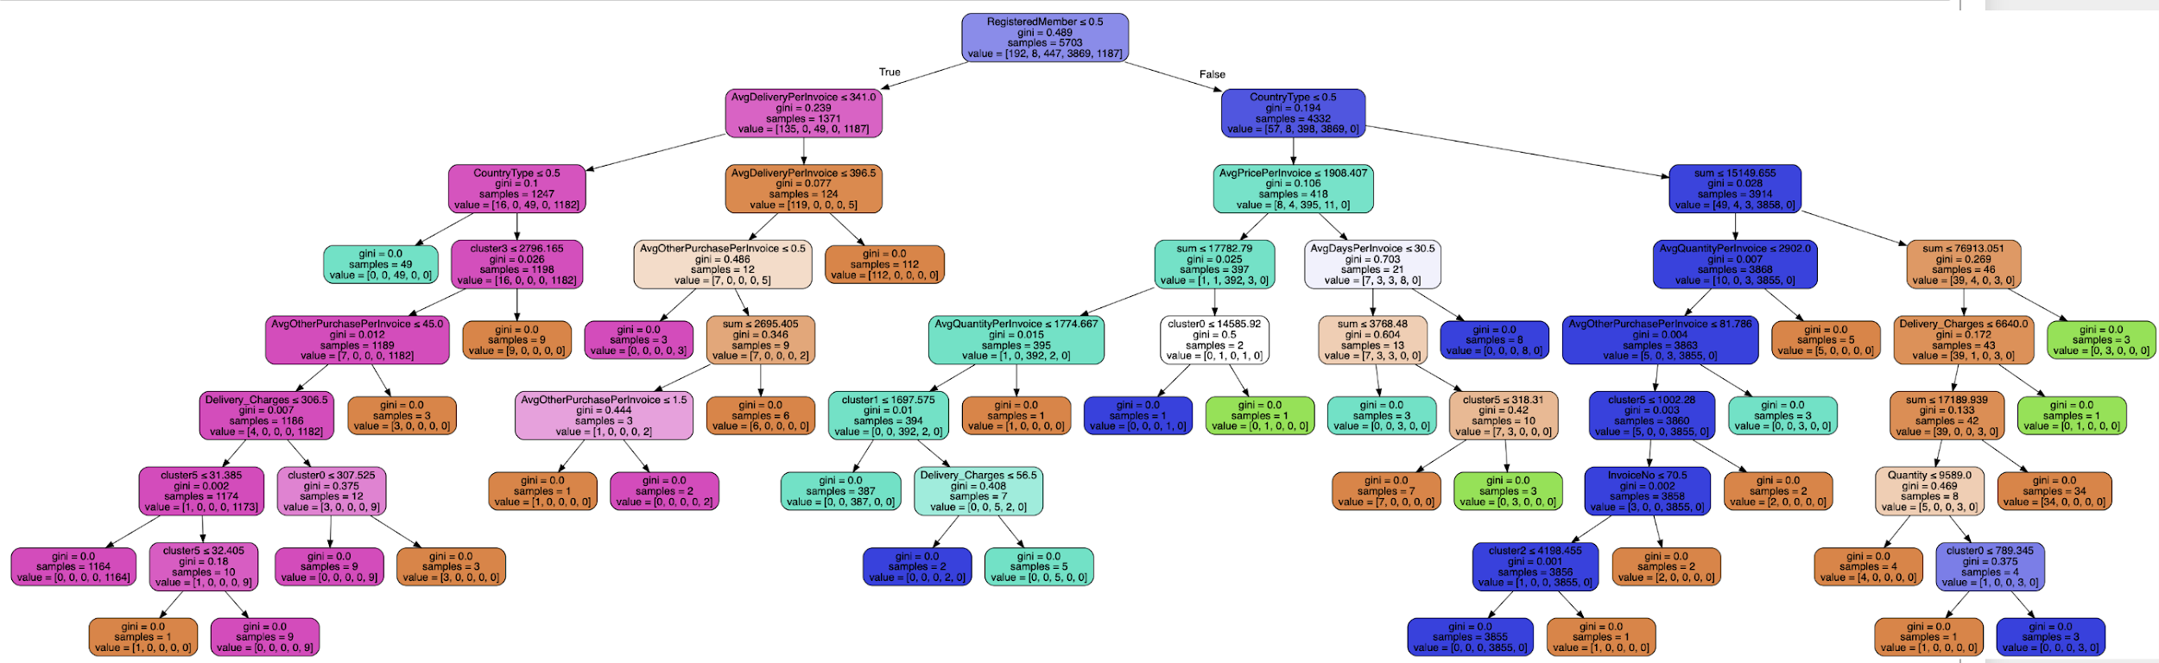
04
Grouping customers into segments
Full Decision Tree
Notes:
Decision Trees are a non-parametric supervised learning method used for both classification and regression tasks.
The goal is to create a model that predicts the value of a target variable by learning simple decision rules inferred from the data features.
Advantages of CART
Simple to understand, interpret, visualize.
Decision trees implicitly perform variable screening or feature selection.
Can handle both numerical and categorical data. Can also handle multi-output problems.
Decision trees require relatively little effort from users for data preparation.
Nonlinear relationships between parameters do not affect tree performance.

Slide 14
Review:
Loyal customers
Transaction Data
You can simply impress your audience and add a unique zing and appeal to your Presentations. Easy to change colors, photos and Text. Get a modern PowerPoint Presentation that is beautifully designed. You can simply impress your audience and add a unique zing and appeal to your Presentations. Easy to change colors, photos and Text. Get a modern PowerPoint Presentation that is beautifully designed.
Heavy occasional customers
Light loyal customer
Customers
Occasional customers
Trialist

Slide 15
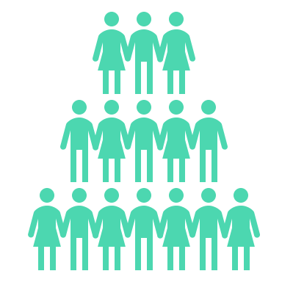






05
Understand their habits
High frequency, high spend
Loyal customers
You can simply impress your audience and add a unique zing and appeal to your Presentations. Easy to change colors, photos and Text. Get a modern PowerPoint Presentation that is beautifully designed. You can simply impress your audience and add a unique zing and appeal to your Presentations. Easy to change colors, photos and Text. Get a modern PowerPoint Presentation that is beautifully designed.
You can simply impress your audience and add a unique zing and appeal to your Presentations. Easy to change colors, photos and Text. Get a modern PowerPoint Presentation that is beautifully designed. You can simply impress your audience and add a unique zing and appeal to your Presentations. Easy to change colors, photos and Text. Get a modern PowerPoint Presentation that is beautifully designed.
Heavy occasional customers
Number of Customers
Transaction Count
Registered Members?
8
Minimum 17
100%
Light loyal customer
Average Quantity Per Transaction (Median)
Average Spend Per Transaction (Median)
Total Spendings (Median)
Occasional customers
1,250
$3,500
$128,000
Trialist
Average Days Per Invoice (Median)
Days Since Last Purchase (Median)
6 Days
2.5 Days

Slide 16
05
Understand their habits
One time purchase
Loyal customers
You can simply impress your audience and add a unique zing and appeal to your Presentations. Easy to change colors, photos and Text. Get a modern PowerPoint Presentation that is beautifully designed. You can simply impress your audience and add a unique zing and appeal to your Presentations. Easy to change colors, photos and Text. Get a modern PowerPoint Presentation that is beautifully designed.
You can simply impress your audience and add a unique zing and appeal to your Presentations. Easy to change colors, photos and Text. Get a modern PowerPoint Presentation that is beautifully designed. You can simply impress your audience and add a unique zing and appeal to your Presentations. Easy to change colors, photos and Text. Get a modern PowerPoint Presentation that is beautifully designed.
Heavy occasional customers
Number of Customers
Transaction Count
Registered Members?
1187
1
0%
Light loyal customer
Average Quantity Per Transaction (Median)
Average Spend Per Transaction (Median)
Total Spendings (Median)
Occasional customers
57
$247
$247
Trialist
Average Days Per Invoice (Median)
Days Since Last Purchase (Median)
0 Days
200 Days

Slide 17
06
Moving Forward
Spend – Frequency Matrix
The size indicates the group size
You can simply impress your audience and add a unique zing and appeal to your Presentations. Easy to change colors, photos and Text. Get a modern PowerPoint Presentation that is beautifully designed. You can simply impress your audience and add a unique zing and appeal to your Presentations. Easy to change colors, photos and Text. Get a modern PowerPoint Presentation that is beautifully designed.
Frequency
Loyal
With the customers segmented, we are able to better:
Personalise our messages to our customers
Make more effective acquisition and retention
Better ROI from Marketing
Unearth New Opportunities
Light Loyal
Trialist
Heavy Occasional
Occasional
Spend

Slide 18
06
Recommendations
Spend – Frequency Matrix
The size indicates the group size
You can simply impress your audience and add a unique zing and appeal to your Presentations. Easy to change colors, photos and Text. Get a modern PowerPoint Presentation that is beautifully designed. You can simply impress your audience and add a unique zing and appeal to your Presentations. Easy to change colors, photos and Text. Get a modern PowerPoint Presentation that is beautifully designed.
Frequency
Acquire trialist – offer a discount code or free delivery upon signing up
Occasional / Light loyalist - offer a return discount code for their next purchase to increase frequency
Heavy occasional – recommend products that are relevant to them so that they can buy more from the site
Loyalist – Create a rewards program so that we can retain them and not lost them to our competitors
Loyal
Light Loyal
Trialist
Heavy Occasional
Occasional
Spend

Slide 19

06
So What??
How does these actions benefit the business??
Number of Customers
Average Spend Per Transaction (Median)
Potential Incremental
Loyal customers
4
8
x
$3,500
=
$14,000
Heavy occasional customers
96
192
x
=
$3,200
$307,200
Light loyal customer
223
=
447
x
$380
$84,740
Occasional customers
1934
$275
=
$531,850
3869
x
Trialist
593
x
=
1187
$247
$146,471
11% of annual revenue!
$1,084,261

Slide 20
THANK YOU !!
Customer Segmentation
for an e-commerce retailer from the UK
Any Questions?
https://cw-customer-segmentation.herokuapp.com/

